Slide 1
Finetuning IEP goals, data collection, and progress reports
Becky Peek, M.Ed.
rpeek@mobility-etc.com

Slide 2
Agenda
IEP true/false
Current topics in special ed IEPs
Writing goals
  Using AI to write goals
  Vision-related goal bank
Data collection ideas
Progress report writing
Summary

Slide 3
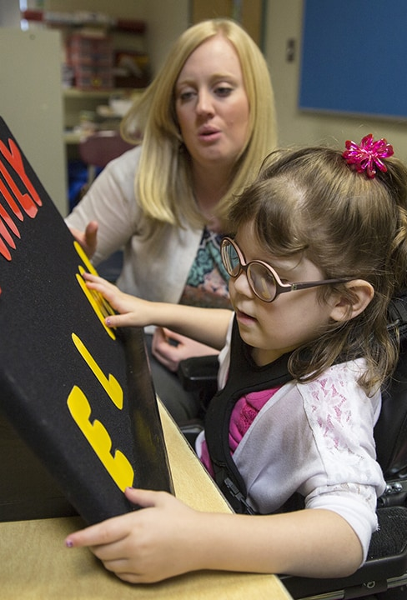
IEP True or False
1.The Expanded Core Curriculum (ECC) assessment is legally required for students with vision impairment in VA.
2. A Functional Vision Assessment needs to be completed as part of every re-evaluation.
3. Students with a 504 plan cannot receive direct services from a TVI.
4. Observing a student in class is considered an indirect service.
5. An eye report from a doctor is necessary to become eligible for vision services.
6. A student can receive vision services even if they do not qualify for special education under the “visual impairment” category.
7. A Prior Written Notice is the document given to parents to inform them of an upcoming IEP meeting.
8. A student can receive Orientation and Mobility services as a standalone service (not tied to vision services).
9. If a parent hires an advocate, the IEP team must send communication to the advocate as well as the parent.
10. If a school division receives a FERPA request, they must send all educational records, emails, assessments, etc. to the parent within 45 days.

Slide 4
True/False Answers
1. False. While an ECC assessment is not legally required in VA, it is practically necessary. IDEA states that student must be evaluated in all areas related to the suspected disability.
2. False, but highly recommended. The FVA may be completed sooner if the team notices any changes that warrant new information.
3. False. Students with a 504 can receive related services like vision if the team decides these services are necessary for equal access.
4. True. Observations are not direct face-to-face instruction. Observations are important; however; and, can be important for collaboration with other teachers and parents.
5. True. According to IDEA, an eye report from a doctor is necessary for vision services.
6. True. Services are determined by a student’s needs for accommodations to access the curriculum. Could be a 504, RTI interventions, or other vision services determined by assessments.
7. False. A PWN is a mandatory document (IDEA) to summarize any changes or proposed changes before they are made. More about PWNs later. . .
8. True. IDEA states that O&M is a related service that does not need to be tied to vision services.
9. False. Team should agree how communication is disseminated though. Make sure there is a signed consent.
10. True. Anything with the student’s name is included.

Slide 5
Current topics
Heavy reliance on student’s unique profile. Conduct and cite assessments in the present levels and in the PWN.
Write goals for and provide instruction for any assistive technology mentioned in the IEP.
Review accommodations and modifications frequently to make sure they’re still relevant.
In 2020, the General Assembly passed Self, Health, and Relationship Education (SHaRE) Consideration Guidelines.
What are you experiencing?

Slide 6

Using Artificial Intelligence (AI) to Write Goals
Playground IEP - free, IEP management tool, free but upgraded version available for a cost
AbleSpace - free, IEP management tool, upgraded version available for a cost
Ai.varsitytutors.com – free, will also help to generate present levels and strengths and weaknesses
Chat GPT, free
Google and Gemini, free

Slide 7
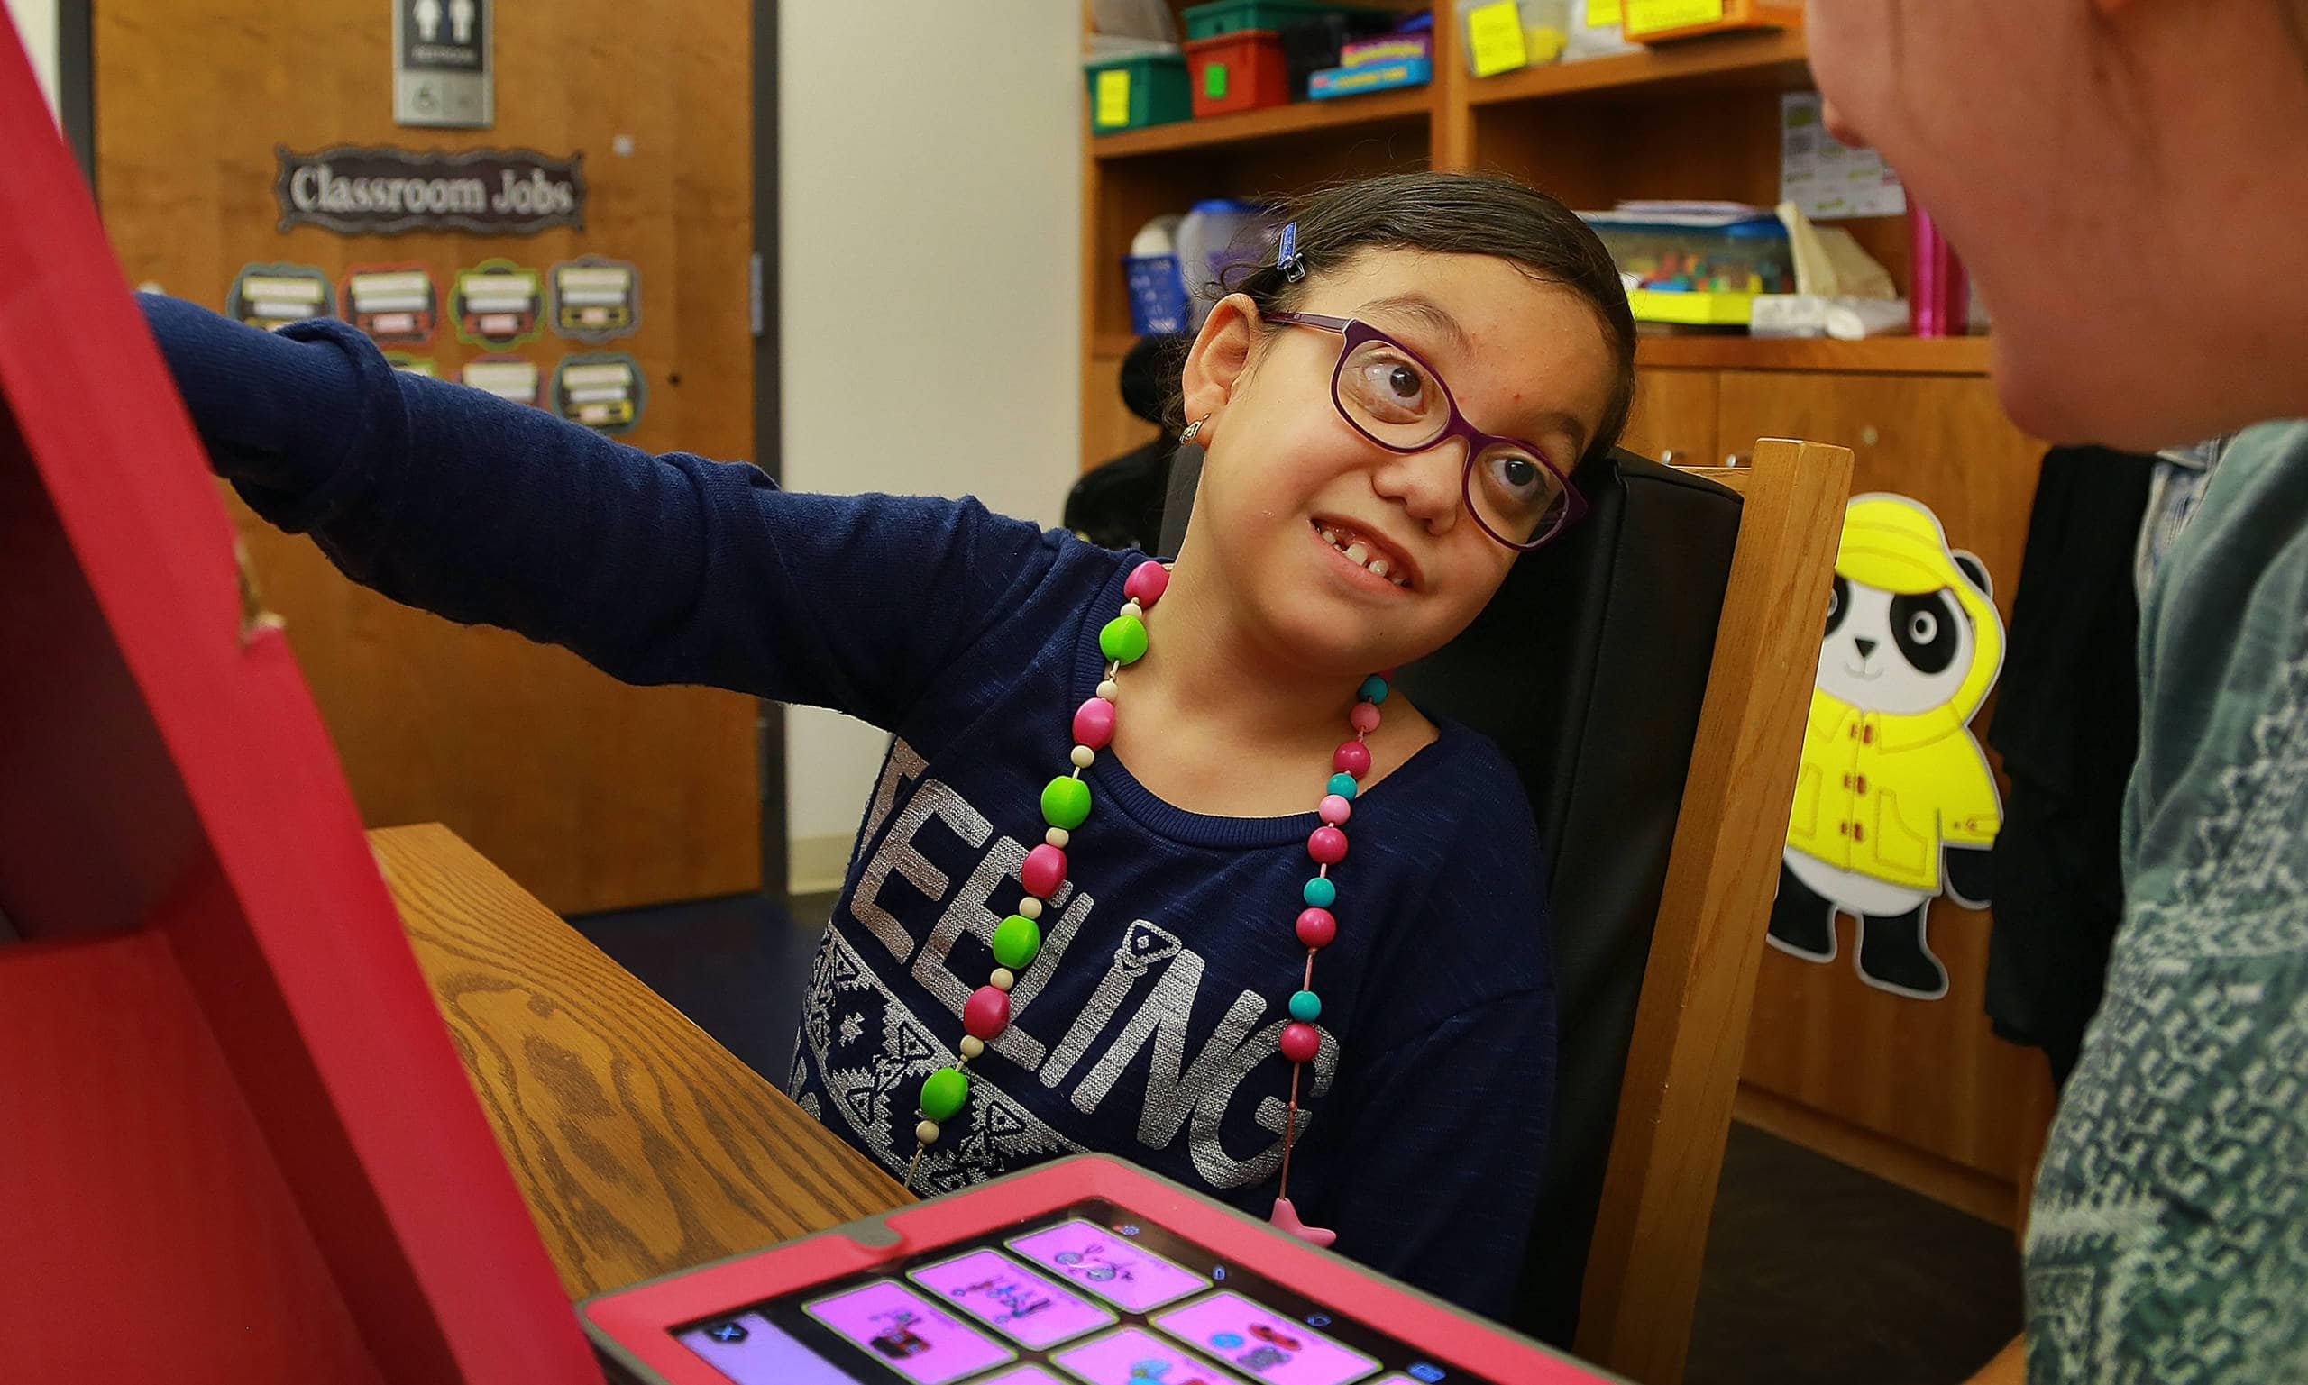
Student 1 - Hannah
Sixth grade student with CVI between Phases 2 and 3 who has difficulty getting started on assignments.
Data shows that even with supports (reduced visual clutter, use of color to highlight directions, simplified directions, teacher restate directions) the student sits and waits for a teacher to get her started.

Slide 8
Chat GPT
When presented with a worksheet or digital assignment with visual supports, Hannah will locate and identify the directions section and verbally restate or point to the first step in 4 out of 5 trials, measured twice a week.

Slide 9

Student 2 - Edmund
High school junior with low vision. Accessing the general curriculum and wants to go to local community college. Hesitant to participate in transition planning. Reliant on teachers and parents.
Data shows he is using many features on his computer (keyboard shortcuts, enlarging features, accessibility features) and is a good self-advocate.

Slide 10
Google
Edmund will prepare a 5-minute presentation or digital portfolio about his post-secondary interests (college, employment, training programs, etc.) and present it to the team using his preferred assistive technology in 3 out of 3 opportunities.

Slide 11
Gemini
When provided with appropriate accommodations and support, Edmund will independently verbalize his preferences and goals related to at least two post-secondary transition areas (e.g., higher education, vocational training, independent living, employment) in 3 out of 4 opportunities, as measured by teacher observation and student self-report.

Slide 12

Student 3 - Casey
First grade student with autism and blindness, learning braille. He loves to write on the brailler but does not like to read what he’s written.
Data shows he knows 20/26 letters, writes his name, puts spaces between single letters and words, knows the number sign (but is not yet using it consistently to write numbers), and can locate tactile pictures on a page.

Slide 13
Ai.varsitytutors.com
Casey will independently decode and read a list of 10 simple words in braille with at least 90% accuracy as measured by weekly progress monitoring and bi-monthly testing.

Slide 14

Try AI to Write a Goal
Think of a student on your caseload and try the AI resources to generate a goal.
Might be interesting to try two or three different resources using the same student to compare.

Slide 15
Goal Banks
Teaching Visually Impaired - teachingvisuallyimpaired.com – breaks goals down by ECC categories. Need to set up a profile.
Paths to Literacy – pathstoliteracy.org – list generated from a variety of teachers and school districts. Labeled by area of need.
Perkins School for the Blind – perkins.org – “How to design IEP goals and objectives for kids with CVI” - template and examples of IEP goals for students with CVI
Keep your own list
Others?

Slide 16
Data Collection
Caseload Information
    Excel spreadsheet with each student on the left-hand side, dates across the top and months on tabs across the bottom for the ability to quickly access when each student was seen and for how long. Separate spreadsheet for each district. Hours recorded every day.
Individual Student Information
Hard copy notebook or file on the computer containing:
  - Basic information to include name, parents’ name and contact information, case manager, teacher(s) and related service providers contact information, ID number(s), schedule, room number(s), IEP date, re-eval date
  - Full IEP or IEP-at-a-Glance
  - Data sheet for each goal
  - Contact log
  - Student work
  Created at the beginning of the year as part of the start of the year routine.

Slide 17
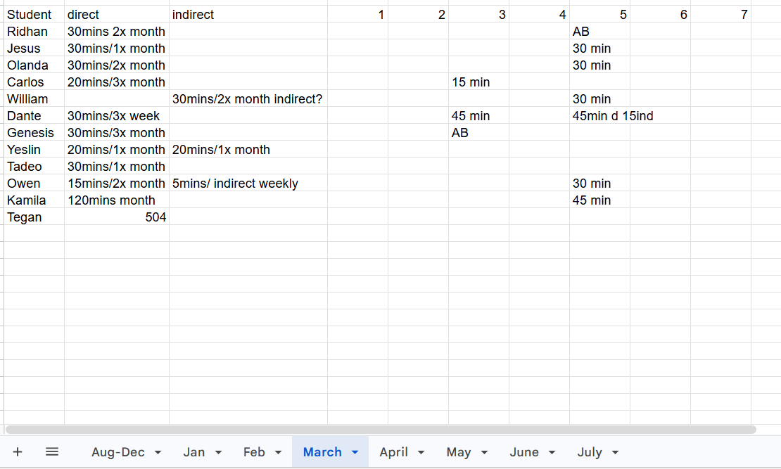

Slide 18
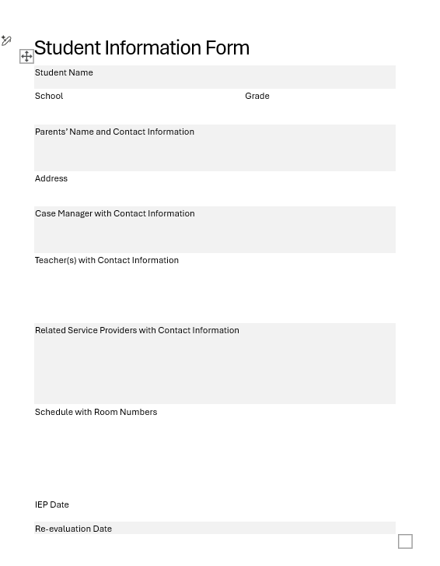

Slide 19
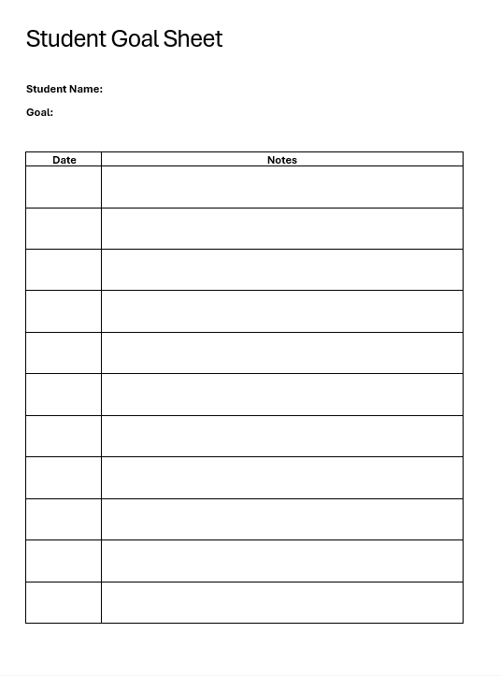

Slide 20
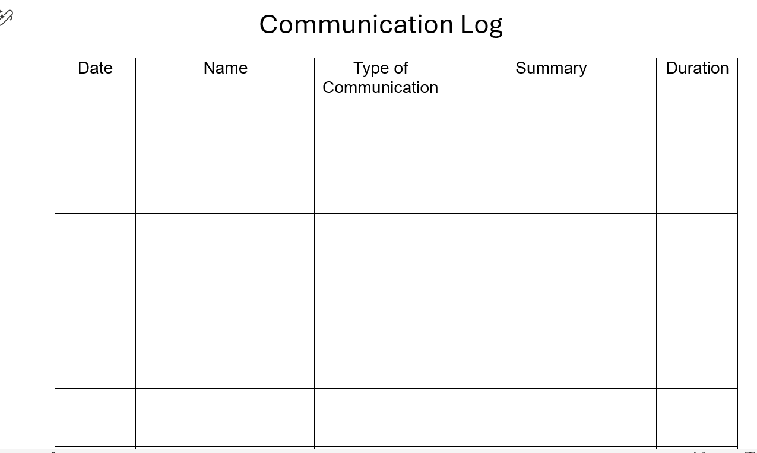

Slide 21
Beginning of the Year
  Get caseload from special education director at each district or at each school. Replicate list from the previous year and ask about changes. Things can change over the summer.
  Read IEPs and check to see if anyone needs orientation to new classroom prior to the start of school. Schedule orientation if needed.
  Make a list of IEP dates and eligibility dates.
  Make data notebooks for each student. Make Excel spreadsheet for each district.
  Email the principal at each school to make introduction and ask for the names of case manager for each student,
  Email IEP team to make introduction. Offer to meet and/or provide summaries/student fact sheets.
  Email parents.
  Start creating schedule.
  Locate and/or order equipment.
  Prepare materials related to student goals.

Slide 22
Progress reports
Simply restate the goal and fill in the numbers.
Goal: Lisa will independently use at least 3 different short cut keys per quarter to navigate documents without a mouse on 4 out of 5 observations per grading period.
Progress report: Lisa used the Windows Key + Plus (magnifier), Windows Key + Minus (Zoom Out), and the Windows Key + ESC to exit on 3 out of 5 observations this grading period.

Slide 23
Summary
Data should shape the goals. Make sure data is accurate and up-to-date. FVAs at least every three years.
There are many sources for goal ideas. Customize them to reflect student’s specific needs.
Keep a digital or paper notebook for each student to reflect all that you’re doing.
Data collection and progress report writing should be fast and easy.
Share things that work for you. We’re a small community that can do a lot to support each other!

Slide 24
Thank you
Becky Peek, M.Ed.
rpeek@mobility-etc.com

